Slide 1
Activities for “The Squiggle”
Book by Carole Lexa Schafer
Power Point by Karen Stafford

Slide 2
Follow with your voice

Slide 3
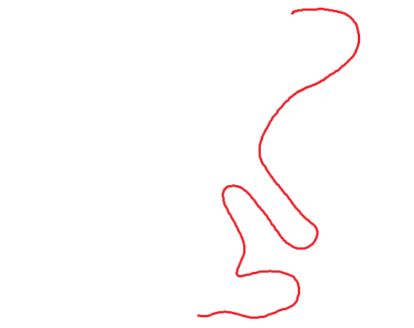
Follow with your voice

Slide 4
Follow with your voice

Slide 5
Follow with your voice

Slide 6
Follow with your voice

Slide 7
Follow with your voice

Slide 8
Follow with your voice

Slide 9
Follow with your voice

Slide 10
Follow with your voice

Slide 11
Now, “draw” the path with your feet.

Slide 12
Now, “draw” the path with your feet.

Slide 13
Now, “draw” the path with your feet.

Slide 14
Now, “draw” the path with your feet.

Slide 15
Now, “draw” the path with your feet.

Slide 16
Now, “draw” the path with your feet.

Slide 17
Now, “draw” the path with your feet.

Slide 18
Now, “draw” the path with your feet.

Slide 19
Now, “draw” the path with your feet.

