Slide 1


The Instrument Hospital
ER Repair and Care for Orff Instruments
Lissa Ray lray123@aol.com teachingwithorff.com

Slide 2
Organize
Label each bar and the resonator box
Keep accidental bars handy
Keep bars with original instruments
Teach kids to remove bars safely
Use the Music Alphabet Song
Teach kids to report problems

Slide 3
Moving and Storage
Place bars on a towel
Roll up and secure
Label bundle
Secure with elastic for short moves
Store in dry conditions
Cover boxes with a dropcloth

Slide 4
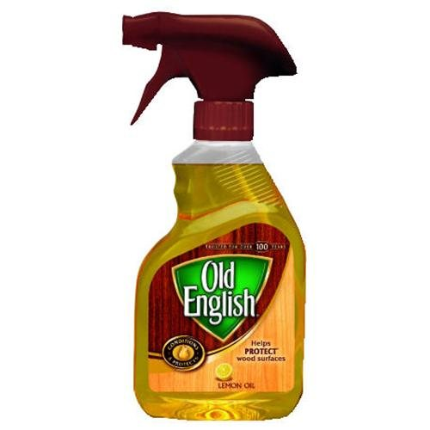
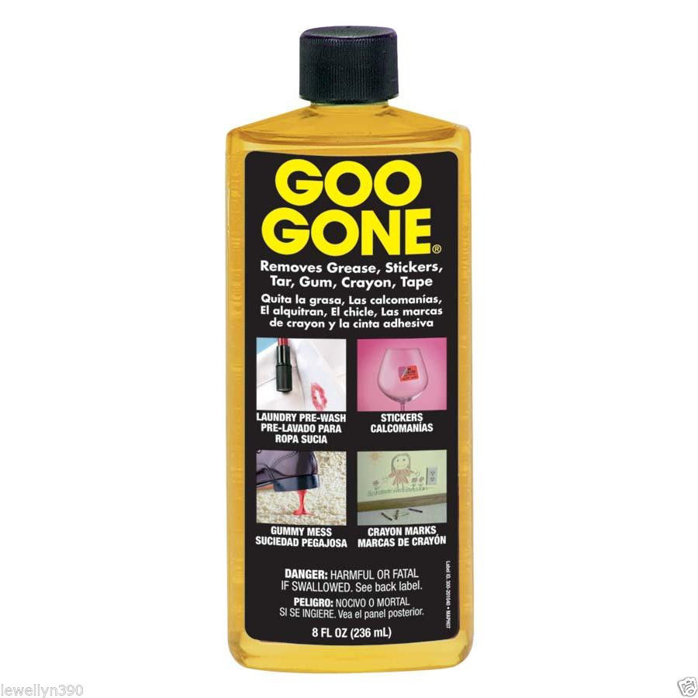
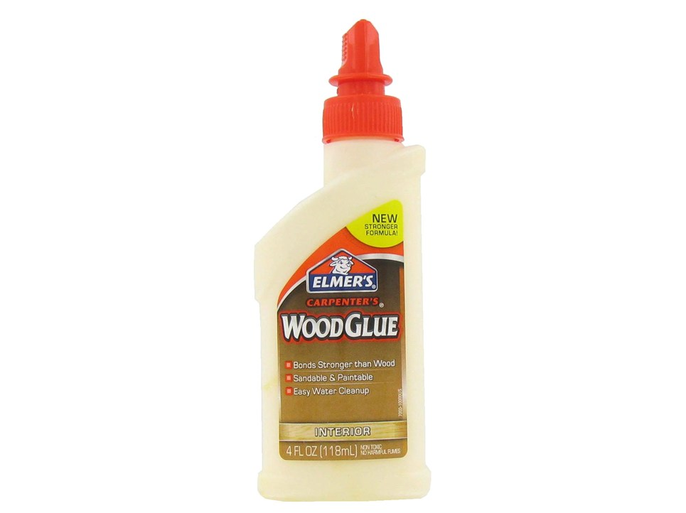
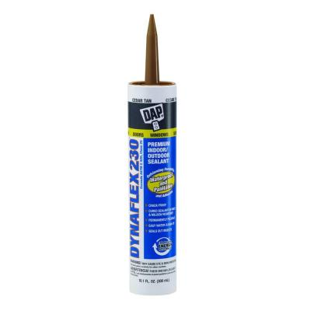
Resonator Boxes
Clean, vacuum
Remove sticky residue
Polish with furniture polish
Caulk seams to fix buzzing
Glue cracks and clamp
Replace missing pieces

Slide 5
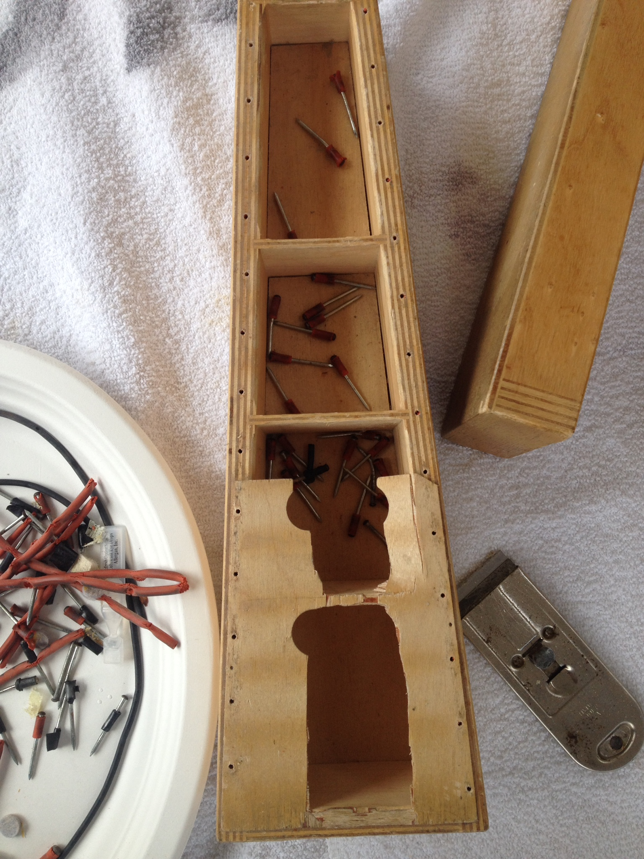
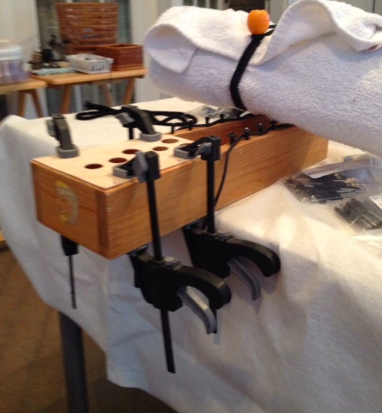
Glue and clamp

Slide 6
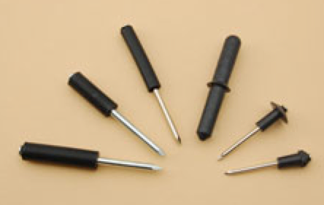
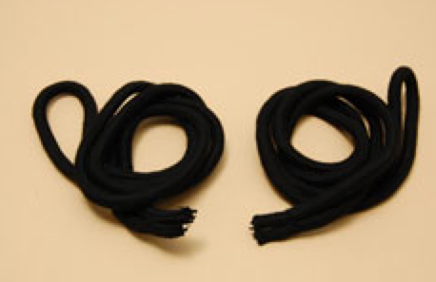
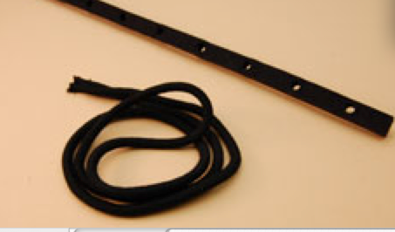
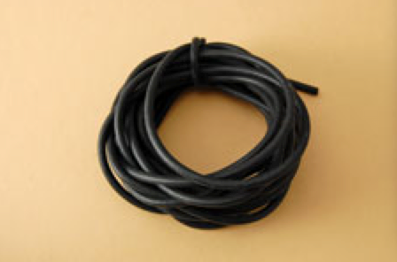
Pins and Tubing
Remove bent pins
Replace with the correct size
Check with manufacturer for questions
Follow original tubing pattern
Secure with tacks at ends

Slide 7
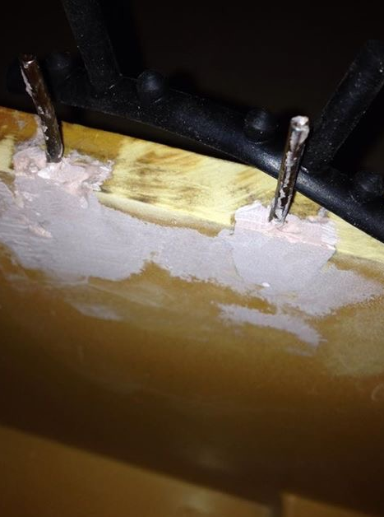
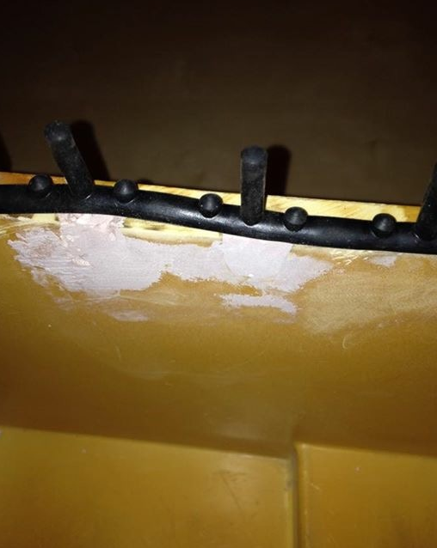
Plastic Boxes
Use Bondo to fix broken boxes, follow instructions on the package, work quickly
After drying, sand to smooth surface
Custom mix paint to match if desired

Slide 8
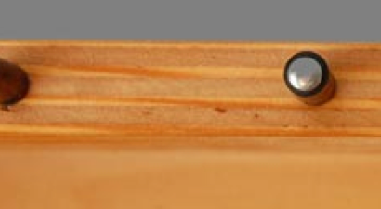
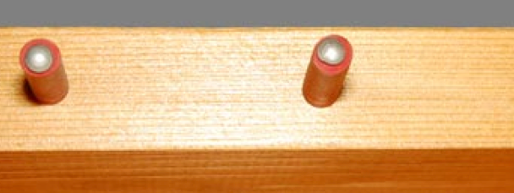
Know your patient’s history.

Slide 9
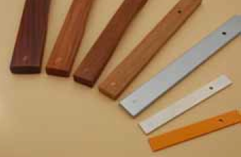
Tone Bars
Xylophones – clean, remove sticky residue
Polish with Old English Scratch Cover
Re-draw letters with fine point metallic pen
Avoid sunlight
Glockenspiels- clean with WD-40
Protect with bore oil or chrome polish

Slide 10
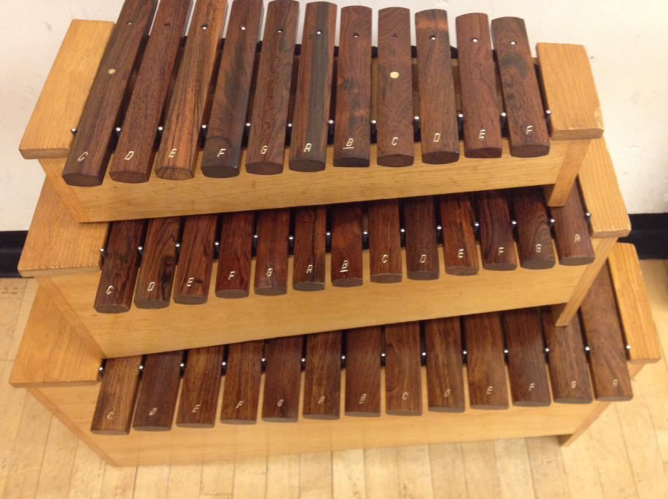
Recovered patients…

Slide 11
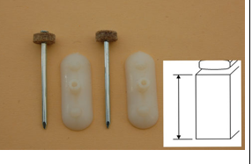
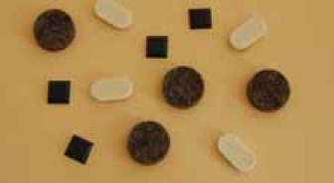
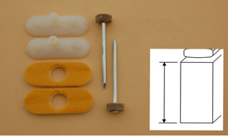
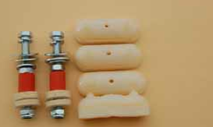
Other parts

Slide 12
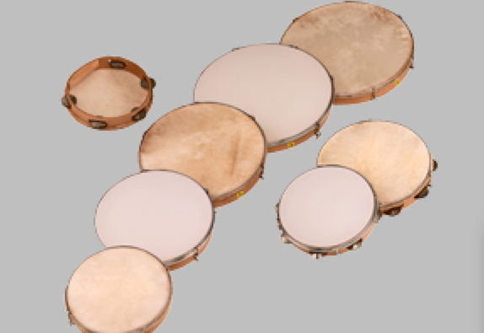
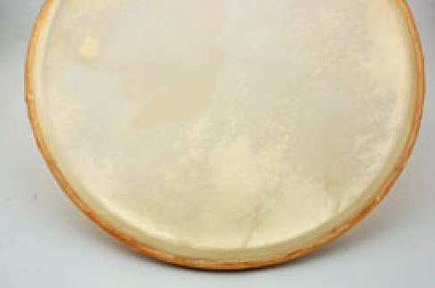
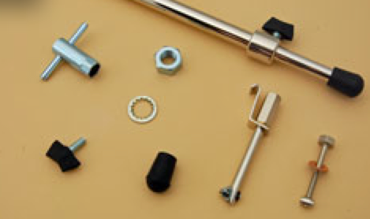
Drums
Loosen heads
Crisscross to tighten
Clean rusted hardware with Naval Jelly
Timpani – label each drum with the range
Use paraffin wax on the rim
Remove dents with hairdryer and ice
Clean plastic heads every year
Silence hardware rattles with thread locking compound

Slide 13
Questions?
Teachingwithorff.com repair videos
lray123@aol.com

Slide 14
Thanks go to:
Michelle Brady/Studio 49/MMB Music
Peggy McCreary / Grenoble Studios
Brian Burnett
Margie Orem
Patty Day

Slide 15
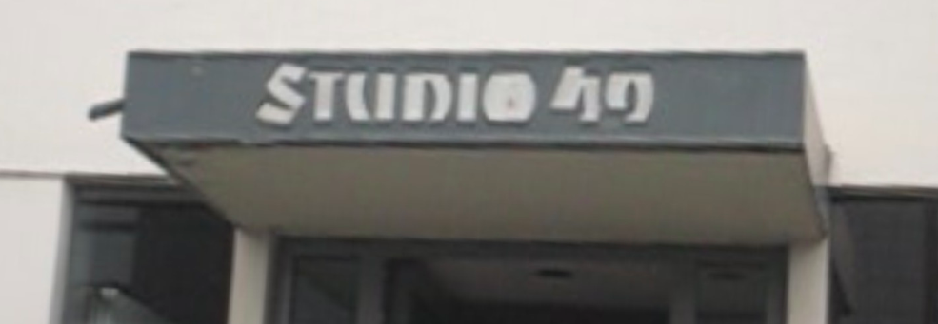
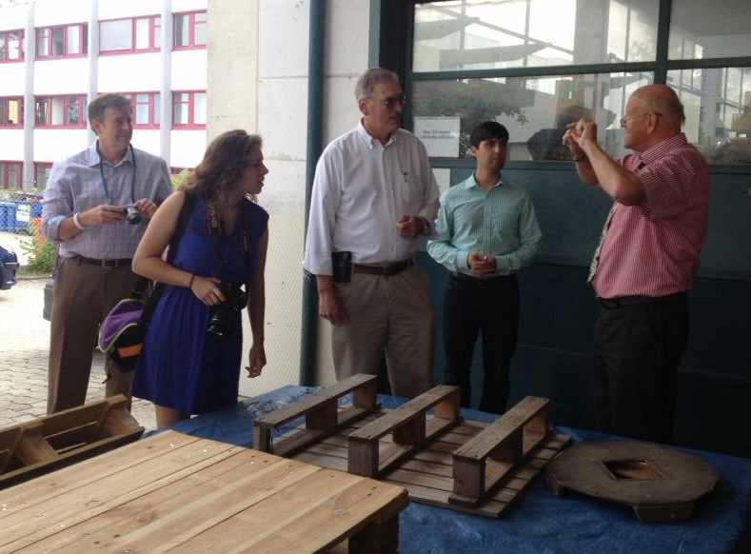
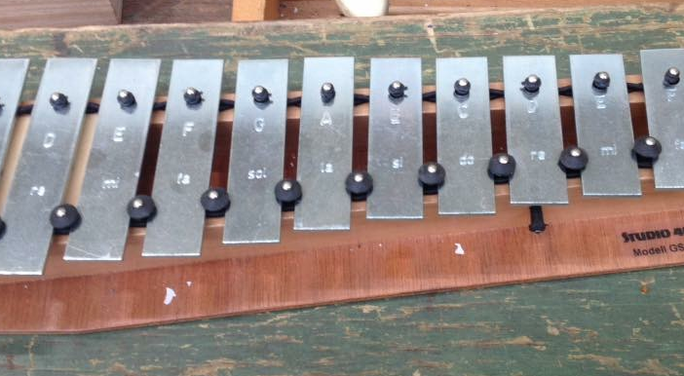
My Summer Vacation

Slide 16
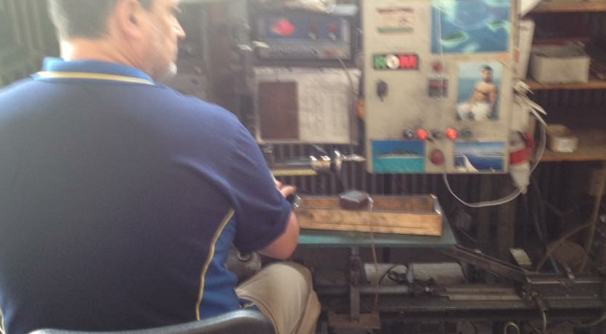
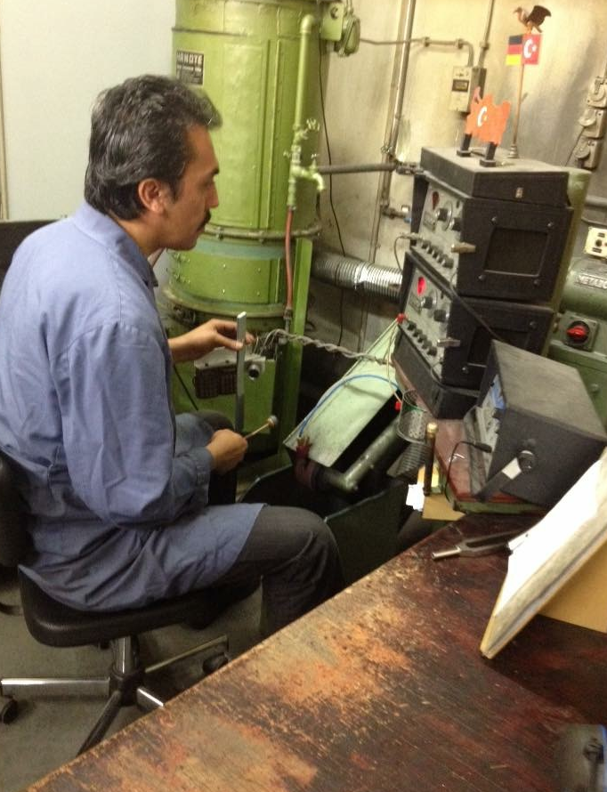

Slide 17
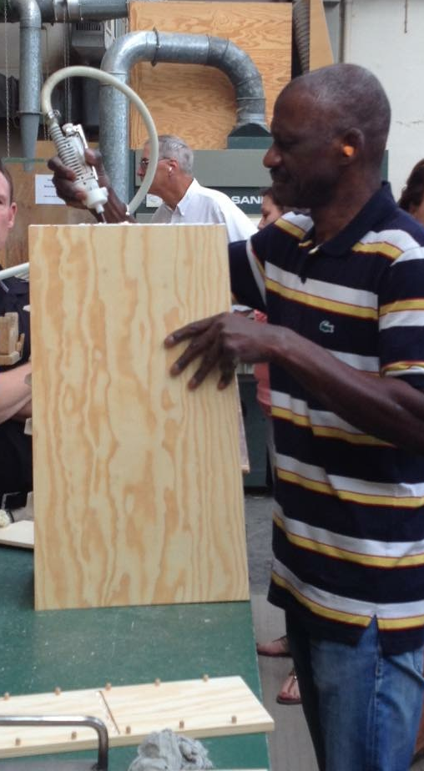
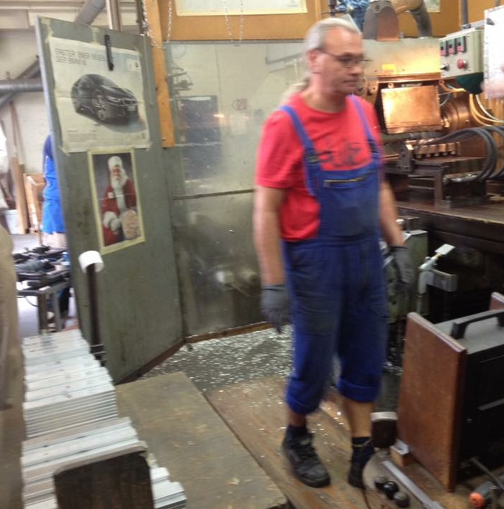
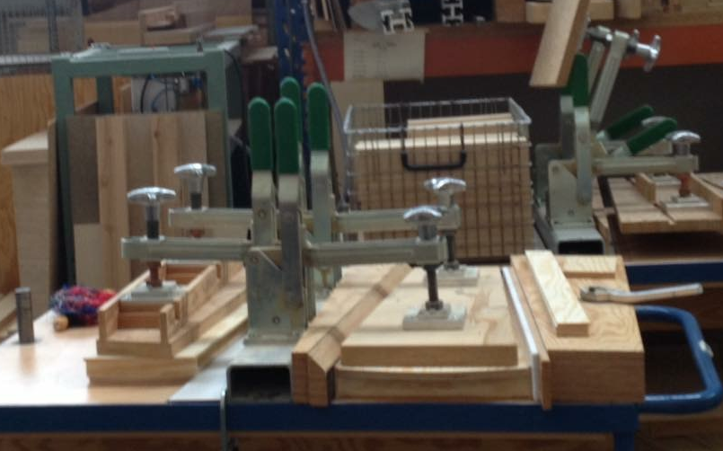

Slide 18
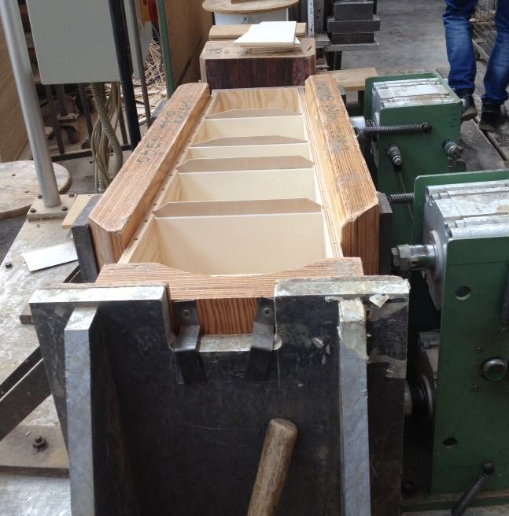
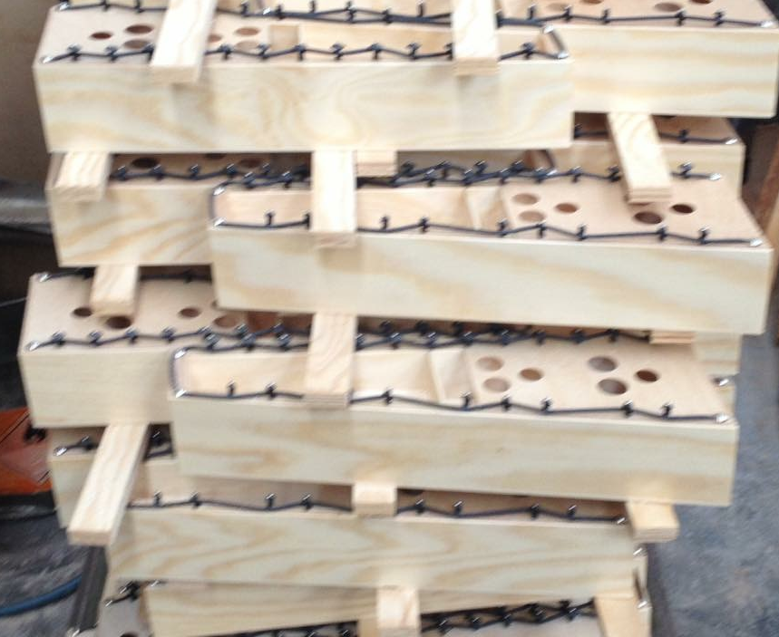
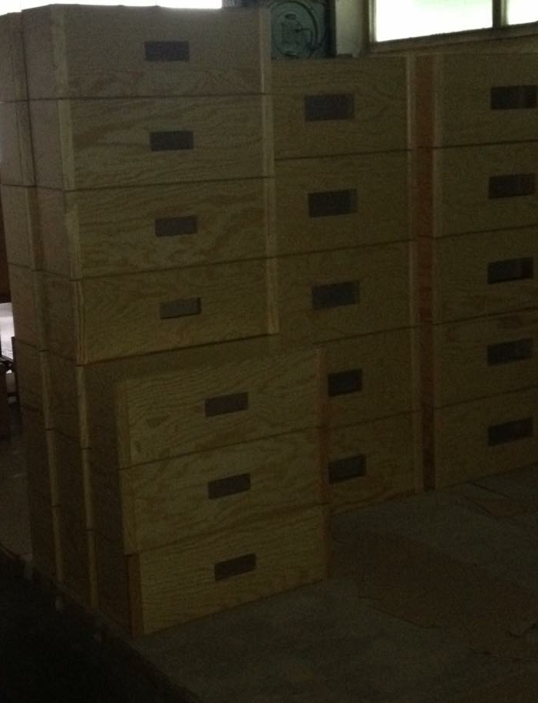
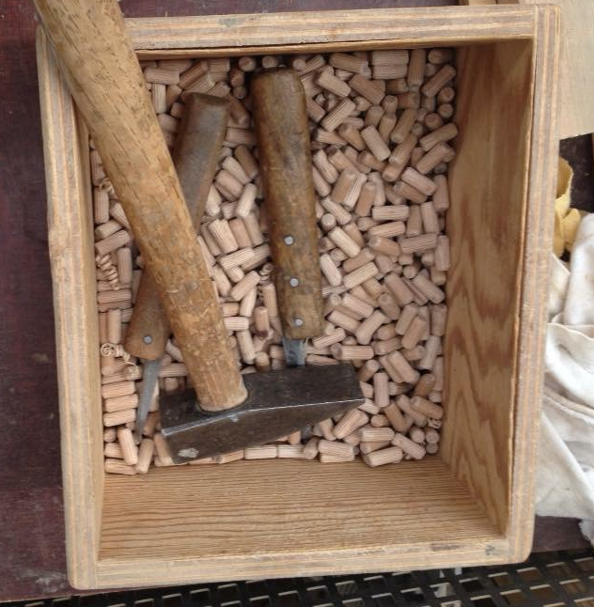

Slide 19
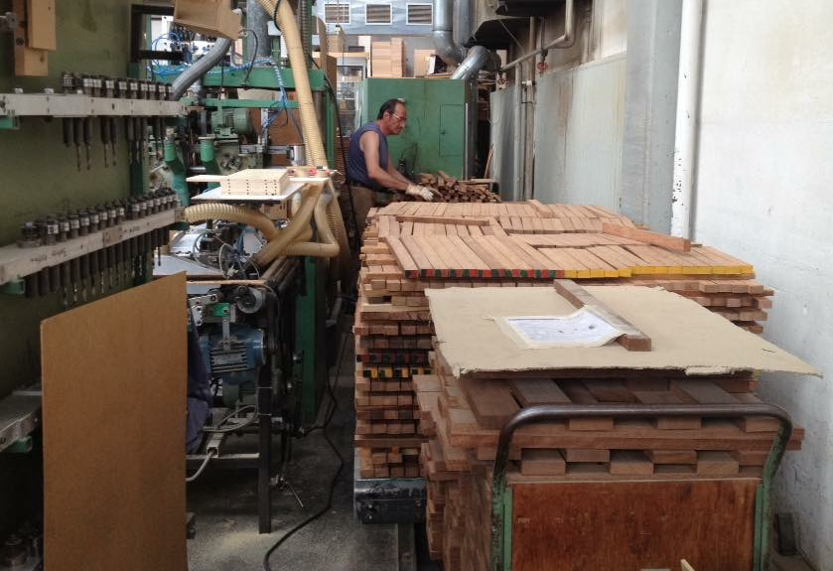

Slide 20
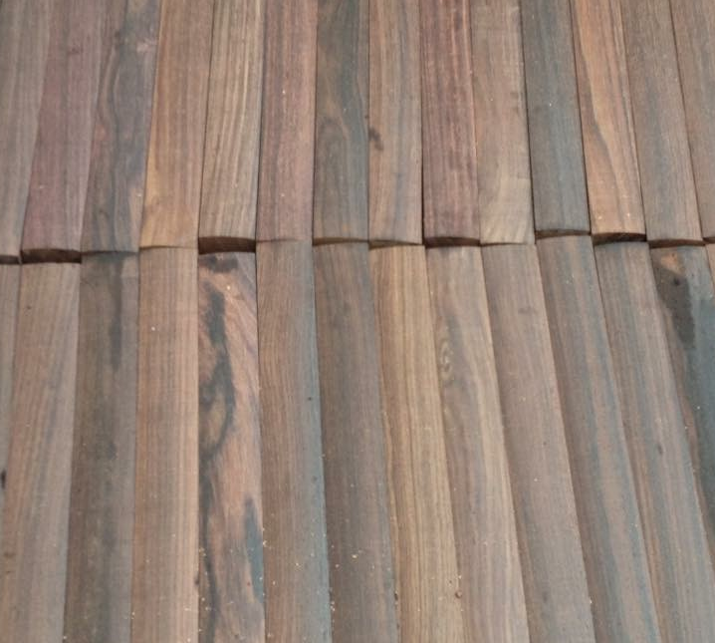
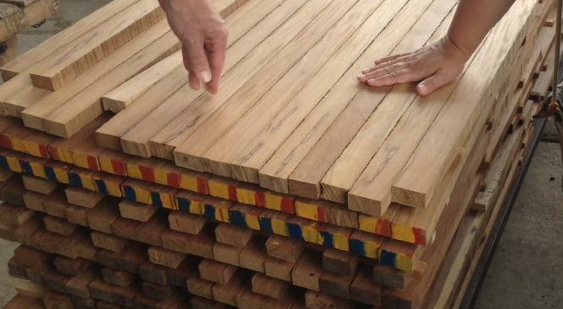
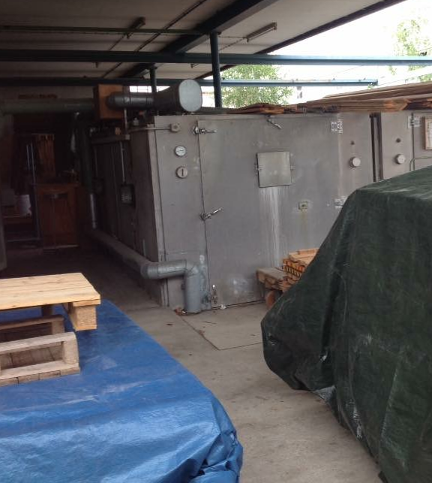
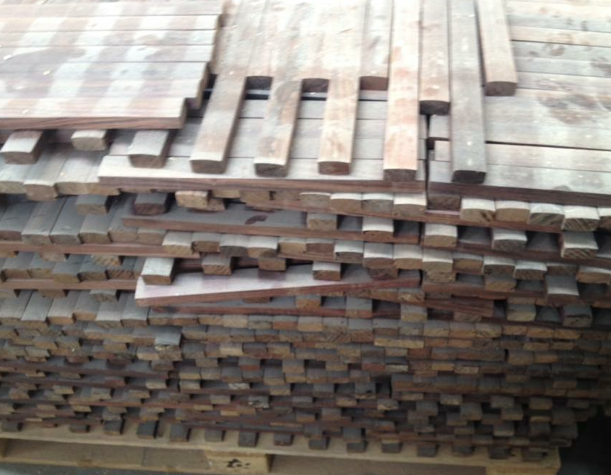

Slide 21
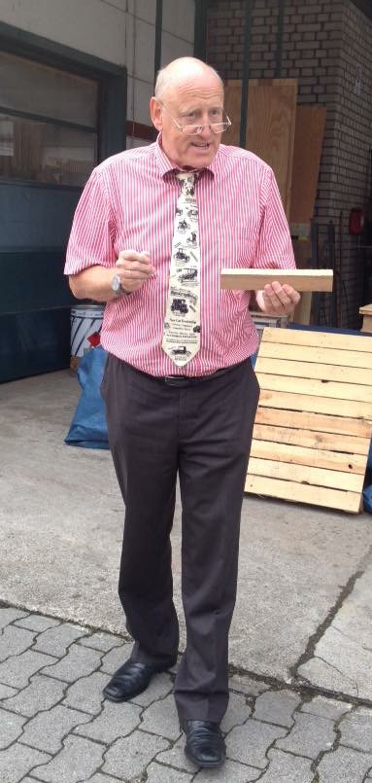
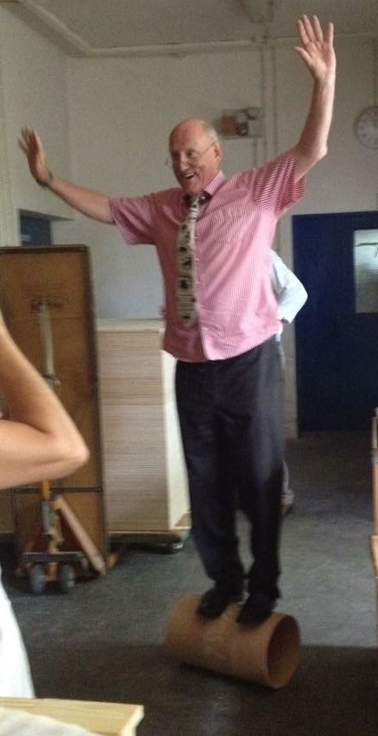
Herr Becker

Slide 22
Questions?
Teachingwithorff.com
lray123@aol.com
GO FIND SOME PATIENTS TO HEAL!

